Slide 1
Identification of Health Risk Factors in Developing Countries using Intrinsic Model Selection Approaches
Daniel Seussler
Master‘s Thesis
supervised by Dr. Cornelius Fritz
Department of Statistics

Slide 2
Introduction

Slide 3
Introduction
Objective:
Identification of risk factors of two common disease burdens in sub-Saharan Africa.
Statistically, how to approach moderate dimensional regression where effect selection is necessary, and how to approach predictive modelling with binomial data where inference on the underlying risk is desired.
Methodology:
Component-wise (model-based) boosting with intrinsic variable selection and model choice.
Data Source: Demographic and Health Surveys (DHS)
Large N household surveys in low- and middle income countries collect data on important population health and socio-economic characteristics.
Often used in the epidemiological literature due to it’s temporal compatibility and representative samples, e.g., in the research of determinants of disease burdens.
I use the Madagascar 2021 Standard DHS and the Mali 2021 Malaria Indicator Survey (MIS).

Slide 4
Component-wise boosting for variable selection and model choice

Slide 5
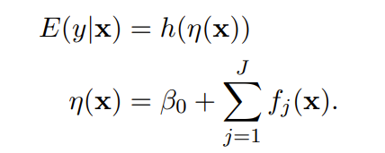
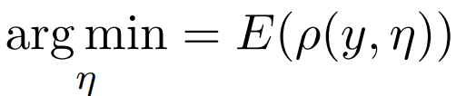
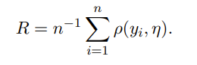
Component-wise boosting
Functional gradient boosting: estimate function by numerical optimisation in function space (Friedmann 2001).
Very popular in the literature given it’s superiority in many tasks (XGBoost). Generally boosted trees but a model based approach is also possible (Bühlmann and Yu 2003, Bühlmann and Hothorn 2007).
Boosting additive models (component-wise). In a generalised additive regression:
We define the following optimisation problem
where ρ is the negative log-likelihood (i.e., loss) and replace the expectation with the empirical risk

Slide 6
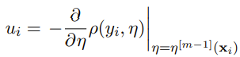
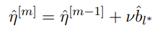
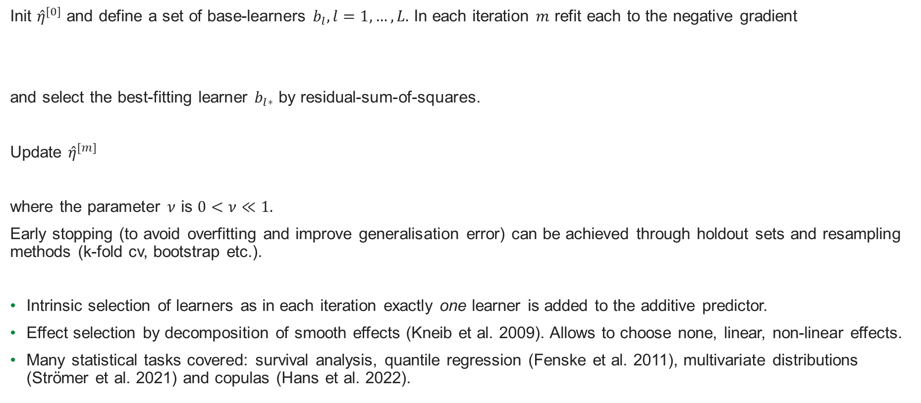
Component-wise boosting
Init ${\hat{η}}^{[0]}$ and define a set of base-learners $b_{l}, l=1,…,L.$ In each iteration $m$ refit each to the negative gradient
and select the best-fitting learner $b_{l∗}$ by residual-sum-of-squares.
Update ${\hat{η}}^{[m]}$
where the parameter $ν$ is $0<ν≪1.$
Early stopping (to avoid overfitting and improve generalisation error) can be achieved through holdout sets and resampling methods (k-fold cv, bootstrap etc.).
Intrinsic selection of learners as in each iteration exactly one learner is added to the additive predictor.
Effect selection by decomposition of smooth effects (Kneib et al. 2009). Allows to choose none, linear, non-linear effects.
Many statistical tasks covered: survival analysis, quantile regression (Fenske et al. 2011), multivariate distributions (Strömer et al. 2021) and copulas (Hans et al. 2022).

Slide 7
Component-wise boosting
Distributional regression (or GAMLSS: Generalised Additive Models for Location, Scale and Shape)
Allows modelling of each distribution parameter with a seperate additive predictor.
Algorithm: non-cyclical boosting. In each iteration both the learner and the parameter are selected jointly for an update.
(see Thomas et al. 2018)
Uncertainty quantification
Subsampling replications or bootstrap replications of the model, but: no theoretical guarantees of coverage.
Use it to assess stability of estimated coefficients.
Stability selection (Meinshausen and Bühlmann 2010) allows for finite sample control of Type 1 error for variable selection, but: very conservative.

Slide 8
Case Studies

Slide 9
Case Study 1: Childhood malnutrition in Madagascar
Objective: Identification of risk factors (or determinants).
Outcome: child is stunted yes / no
(height-for-age score is more than 2σ below the reference)
Explanatory Covariates:
Individual-level risk factors (age, gender, mother’s bmi, if twin, etc.) ,
household- (no. of household members, DHS wealth index, etc.),
and community-level (urbanicity, distance to healthcare facilities etc.).
Additional Specifications:
Decomposition of smooth effects for continuous covariates to allow for effect selection.
Markov random field for administrative regions (first-order neighbourhood structure).

Slide 10
Case Study 2: Geographic malaria risk in Mali
Objective: Identification of environmental correlates of malaria prevalence and inference of risk.
Outcome: k children out of n tested positive in cluster c, i.e., binomial.
Following Dong and Wakefield 2021, I model the outcome with a beta-binomial distribution that accounts for cluster overdispersion due to within-cluster variability.
Explanatory Covariates:
Elevation, land surface temperature (day/night), rainfall - aggregated annually (mean / sum).
Vegetation indices, NDVI and EVI.
Population (Global Human Settlement Layer Data).
Urbanicity variable to account for survey design.
Additional Specifications:
Decomposition of smooth effects for continuous covariates to allow for effect selection.
Bivariate tensor P-spline to model spatial effects.

Slide 11
Results

Slide 12
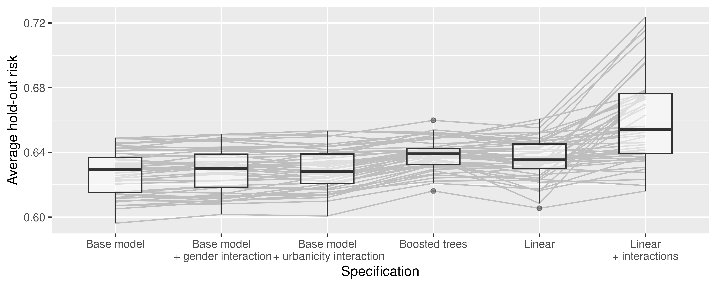
Childhood malnutrition in Madagascar
Model selection
by three-way holdout method (70/20/10), no. of boosting iterations selected optimal performance on validation set.
Following results based on 50 subsampling replications. Red line indicates pointwise average.

Slide 13
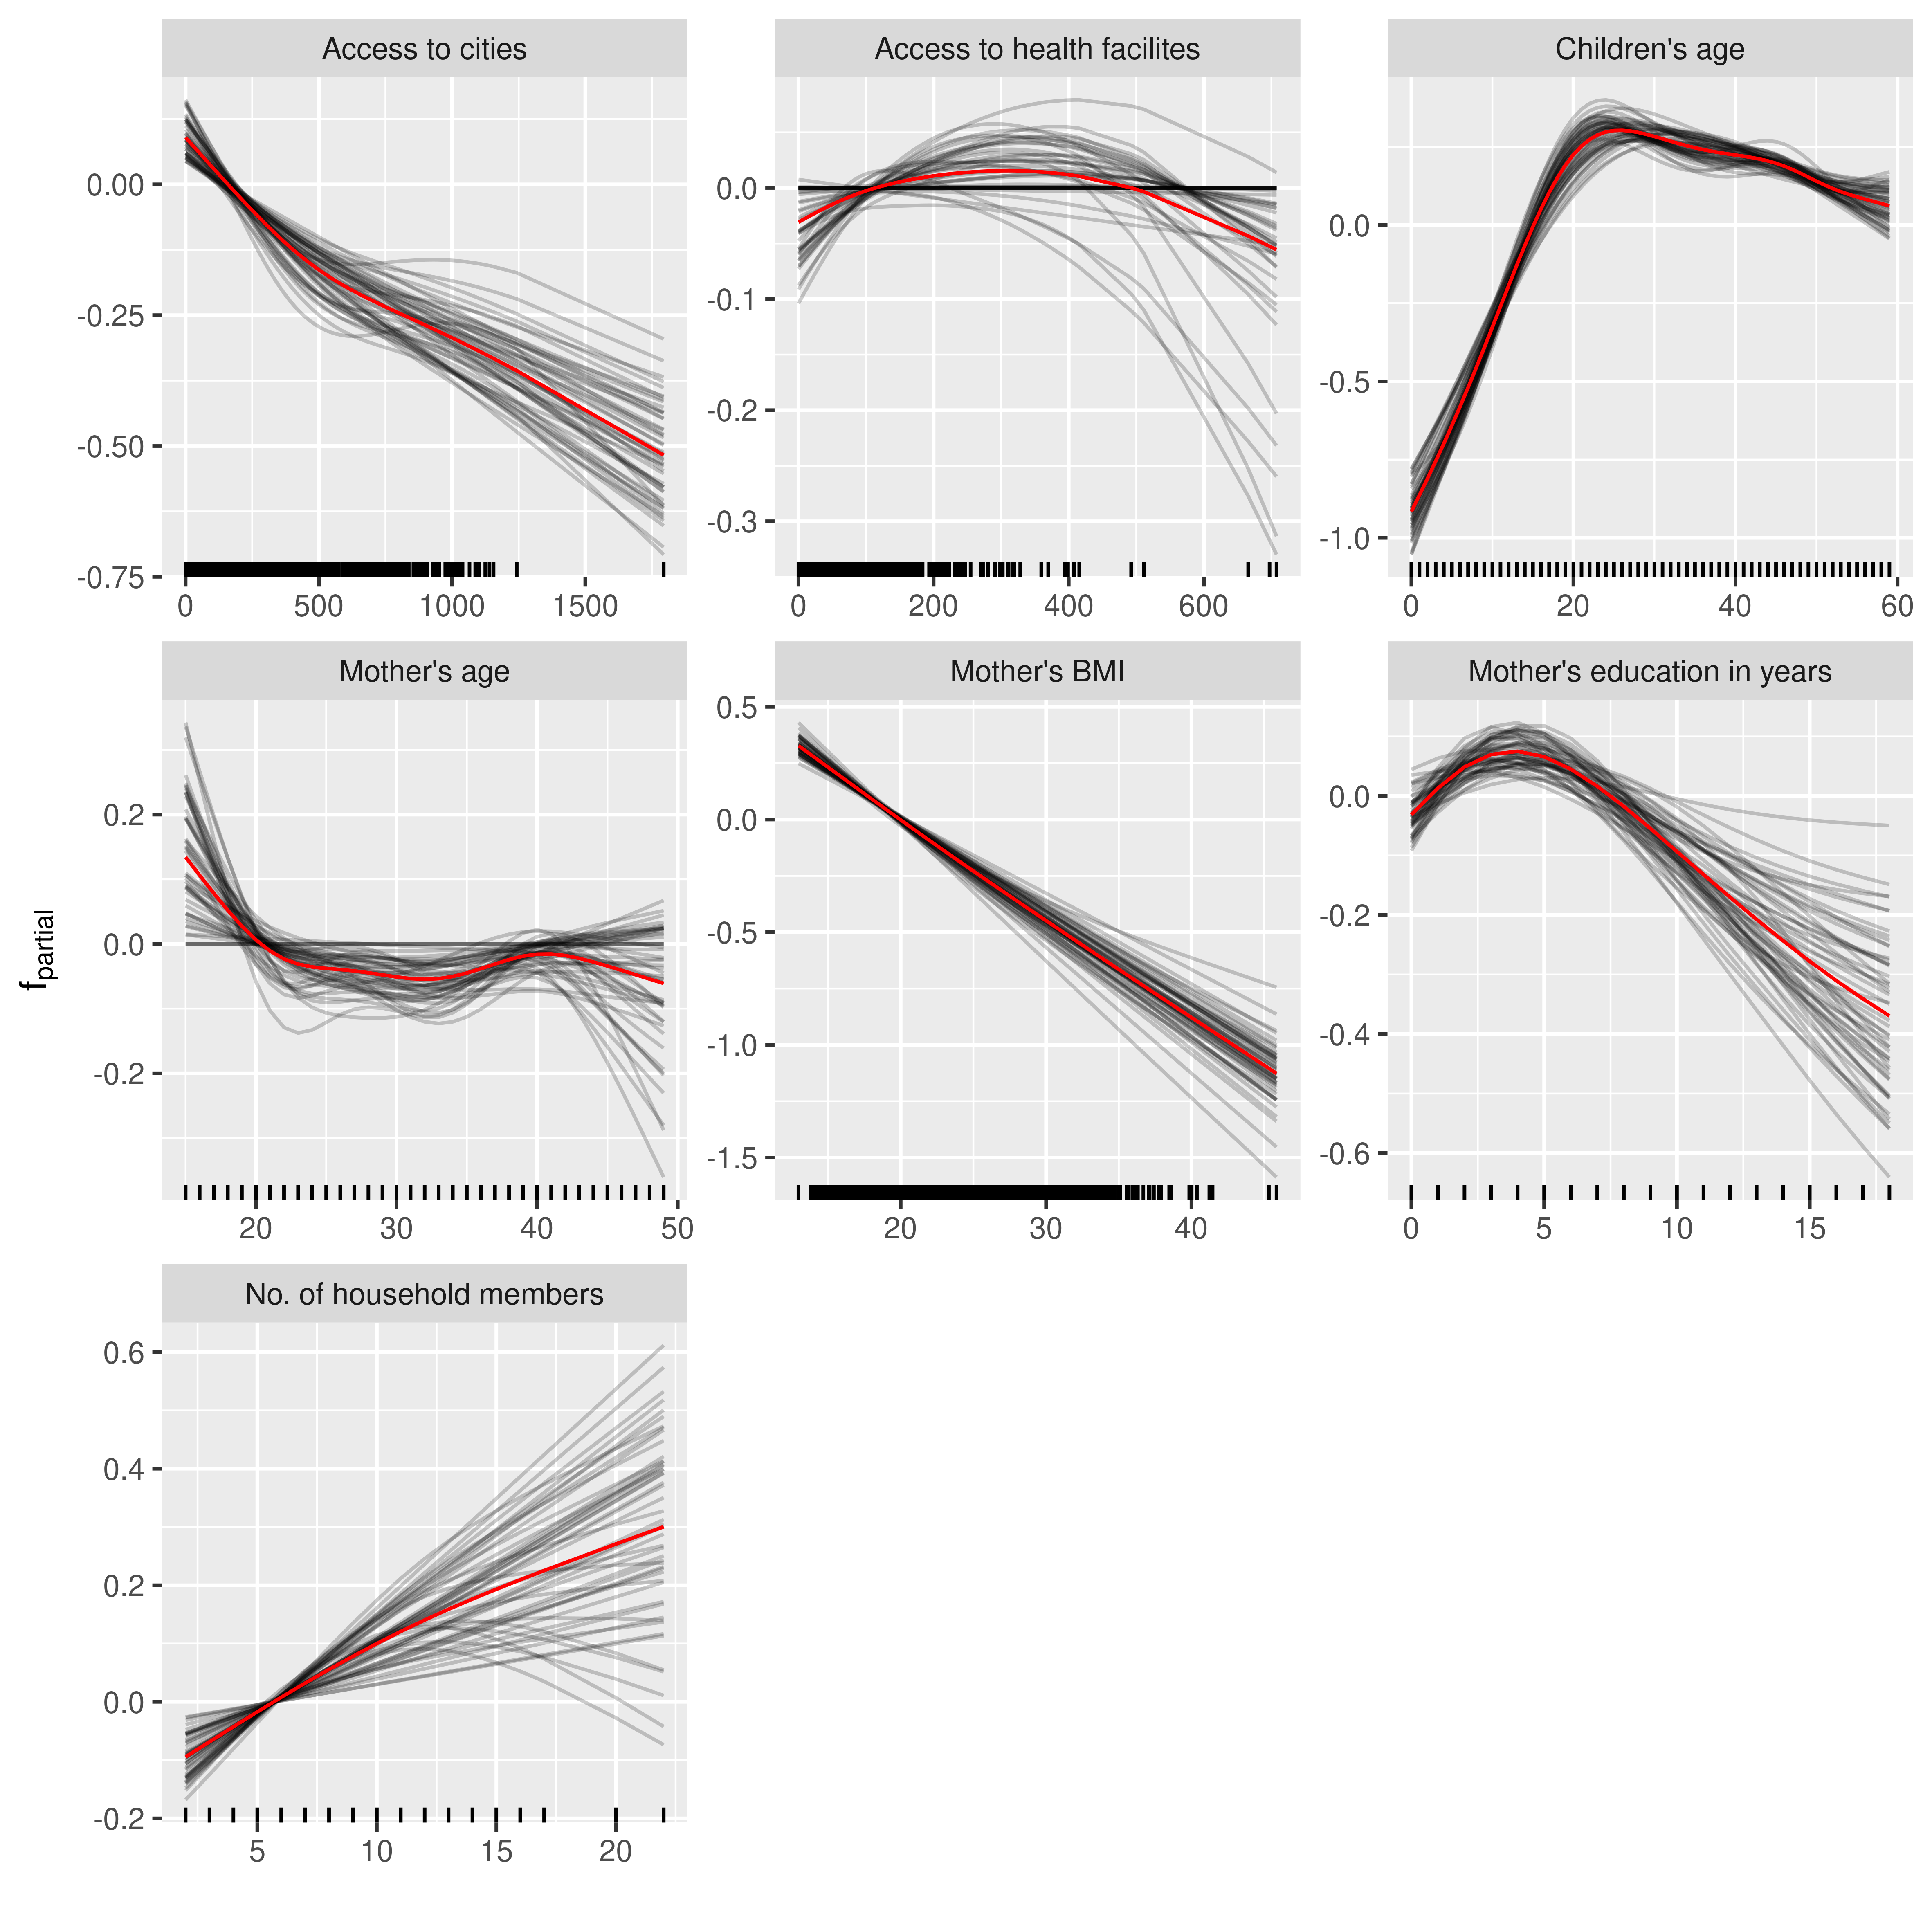
Childhood malnutrition in Madagascar
Estimated effects of the continuous covariates.

Slide 14
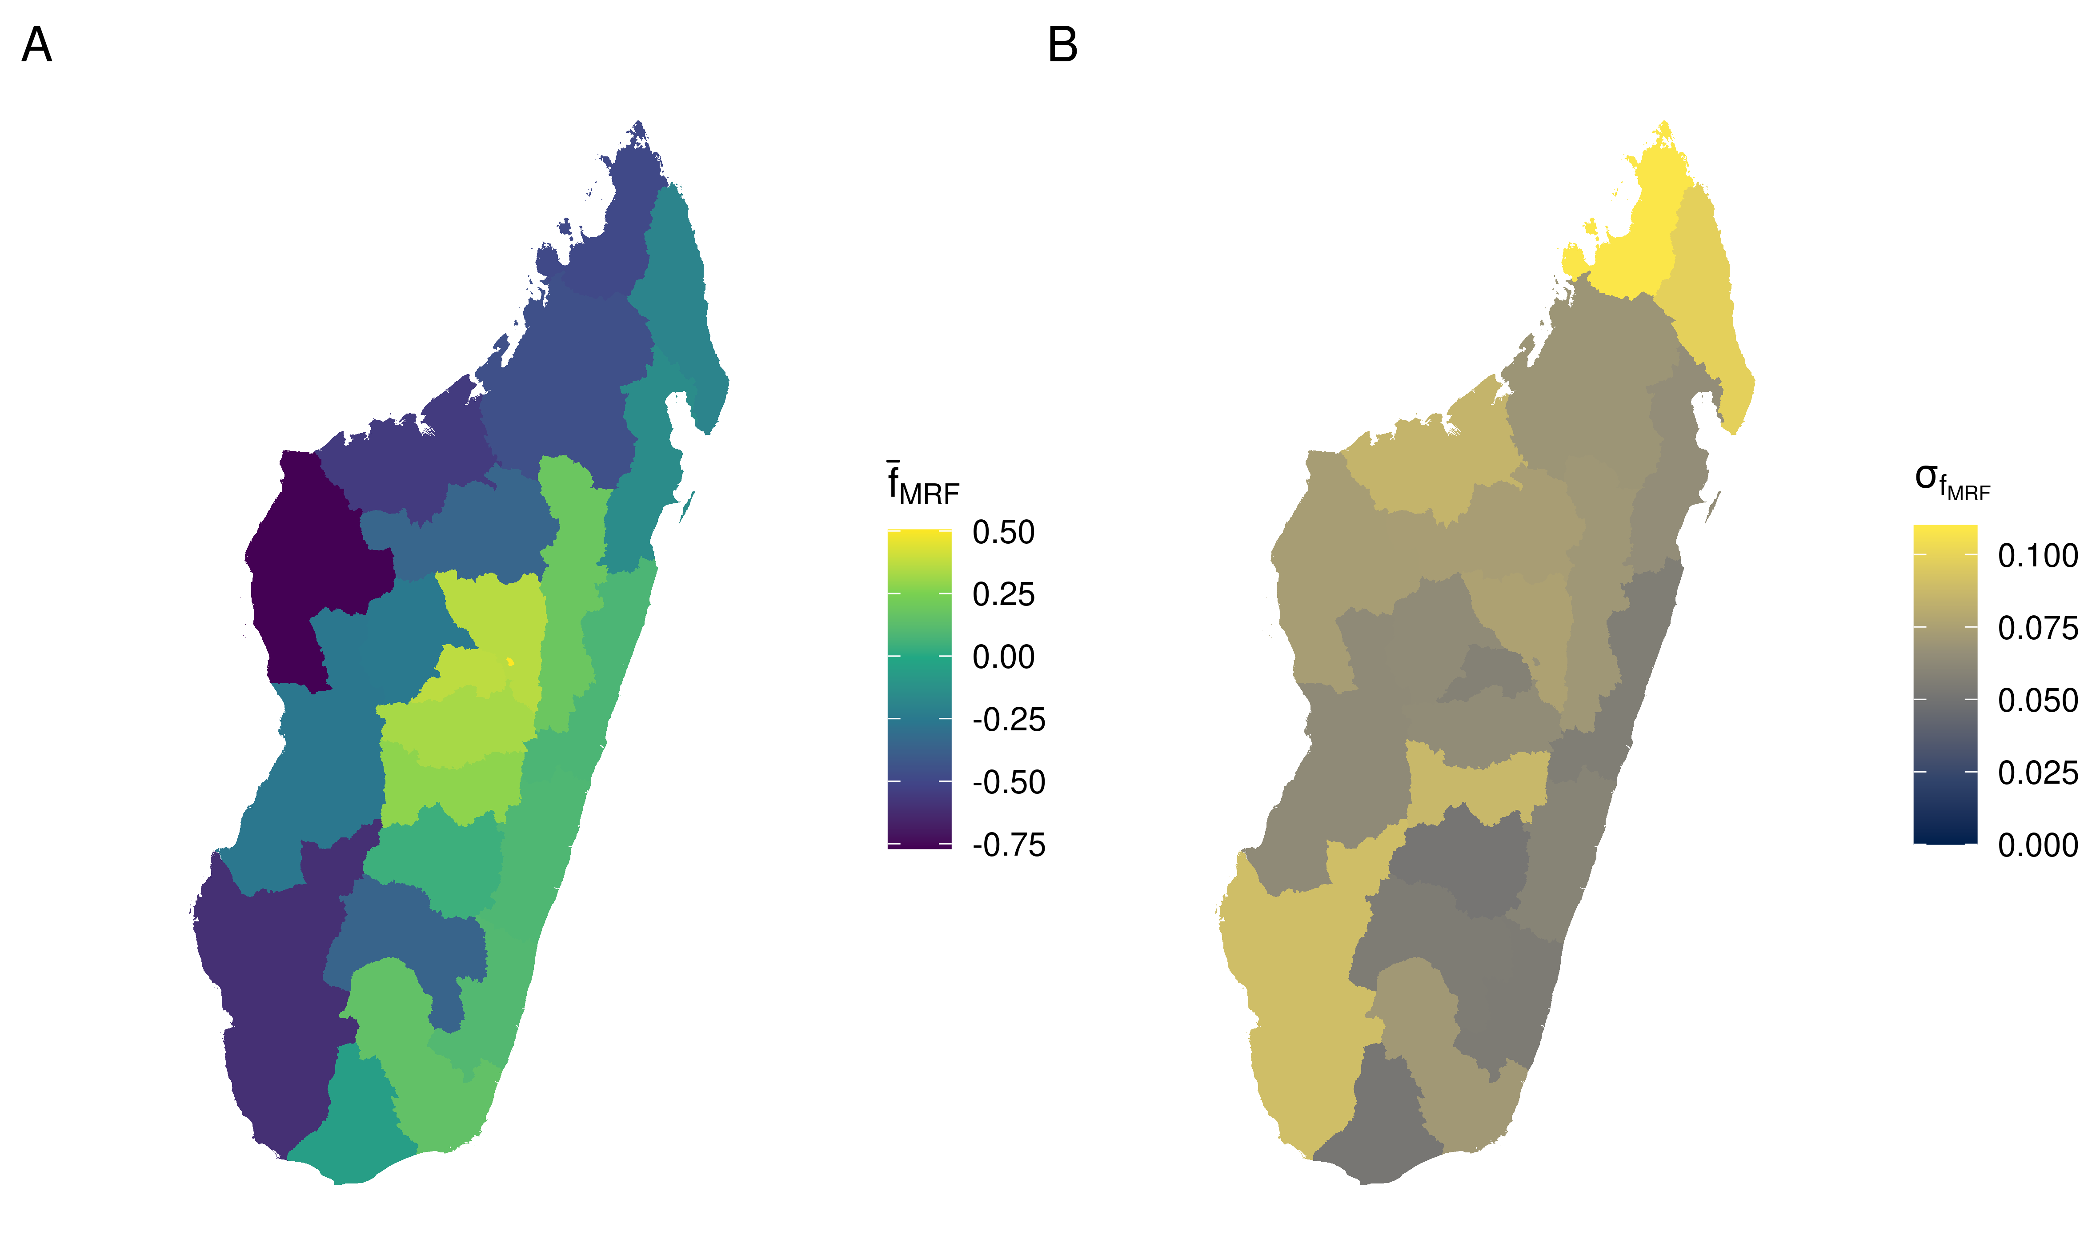
Childhood malnutrition in Madagascar
Markov random field effect for admin 1 regions, mean (A) and standard deviation (B) of the subsampling replications.

Slide 15
Geographic malaria risk in Mali
Model validation and selection
by nested cross-validation (10-fold, stratified by region)
comparison of base specification to boosted trees and
Linear
Linear + bivariate tensor P-spline
Linear + climate interactions + bivariate tensor P-spline
Linear + spatially-varying coefficient
Early stopping by 10-fold cross-validation. Uncertainty quantification with bootstrap samples.

Slide 16
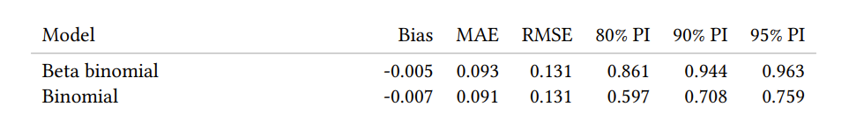
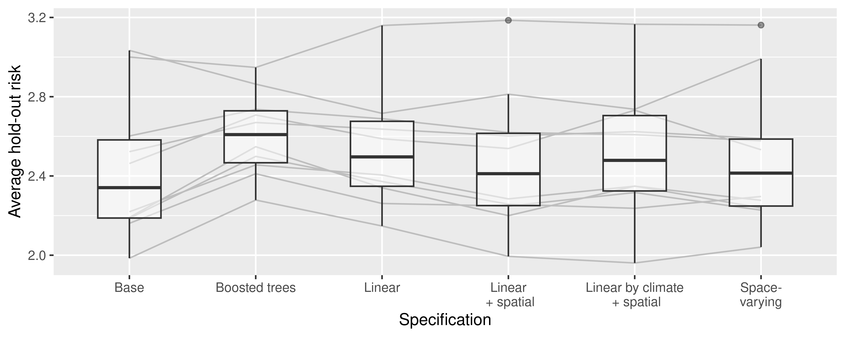
Geographic malaria risk in Mali

Slide 17
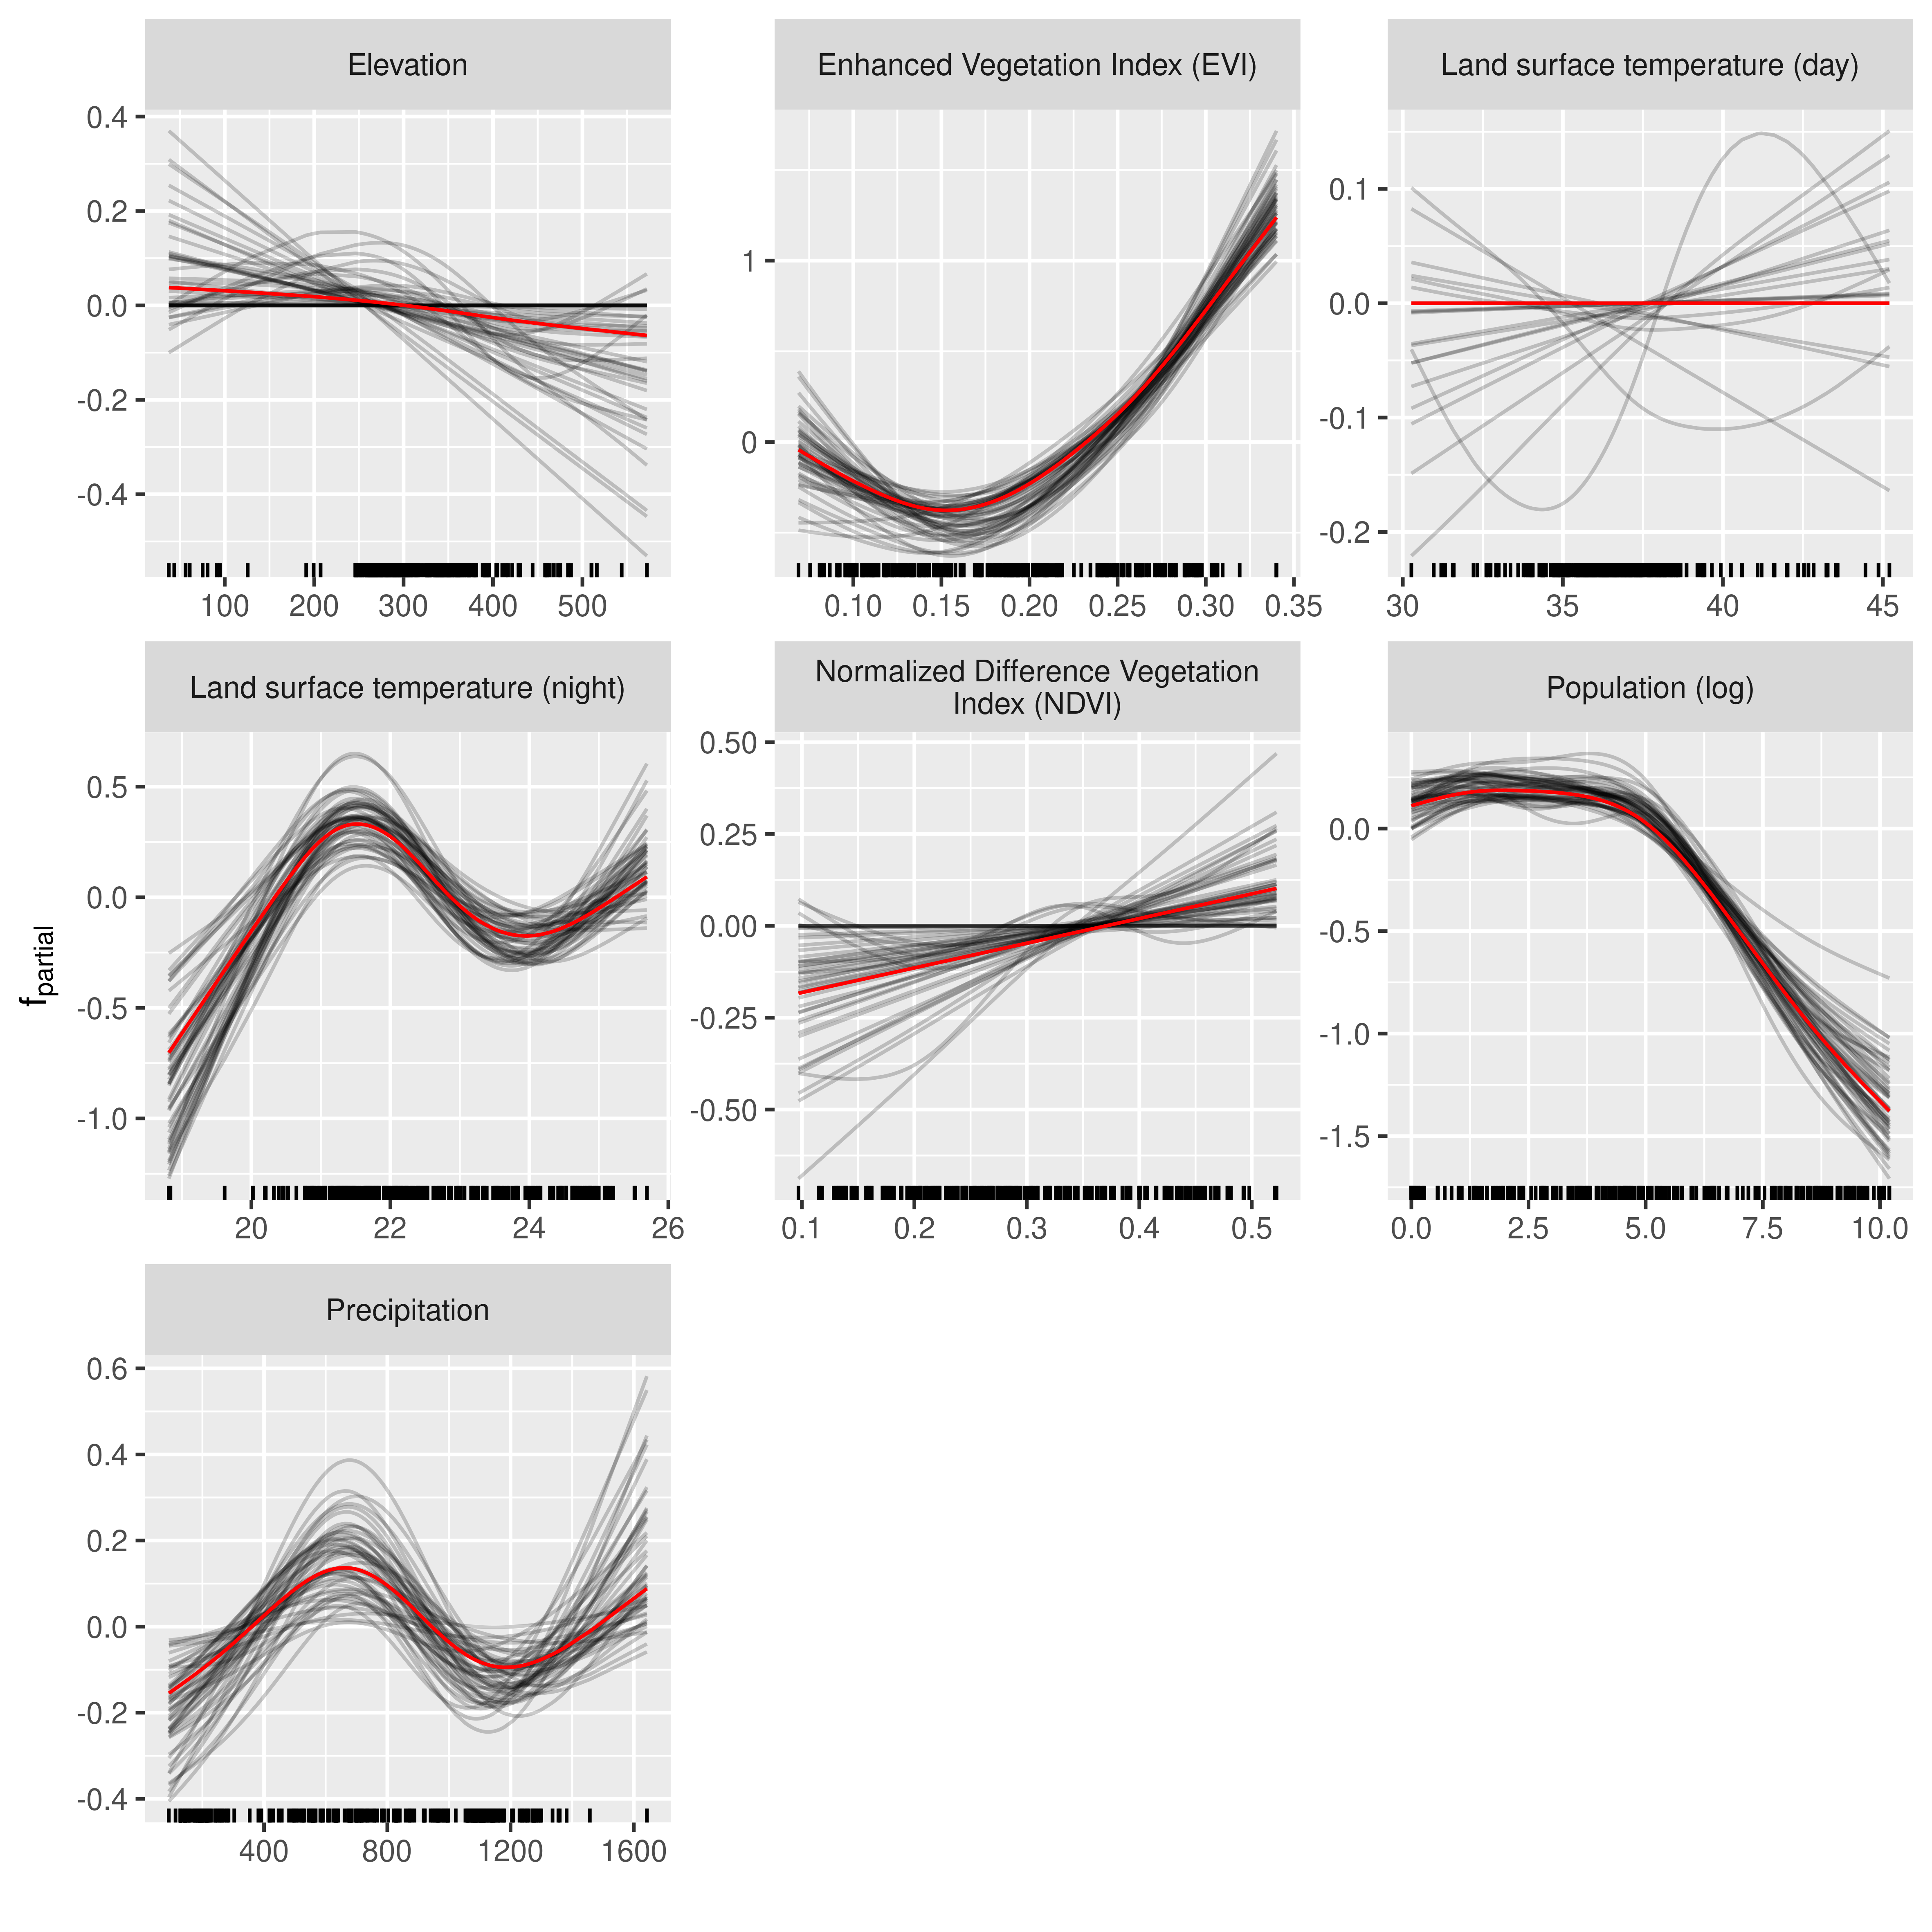
Geographic malaria risk in Mali
Red line / dot indicates estimate of the principal model.
Uncertainty quantification based on 50 bootstrap samples.

Slide 18
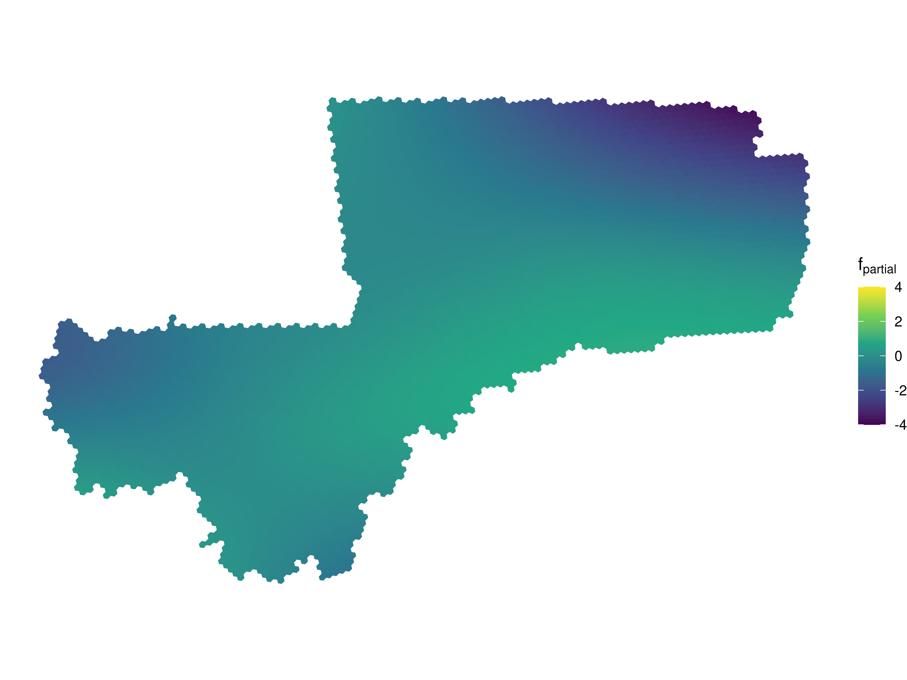
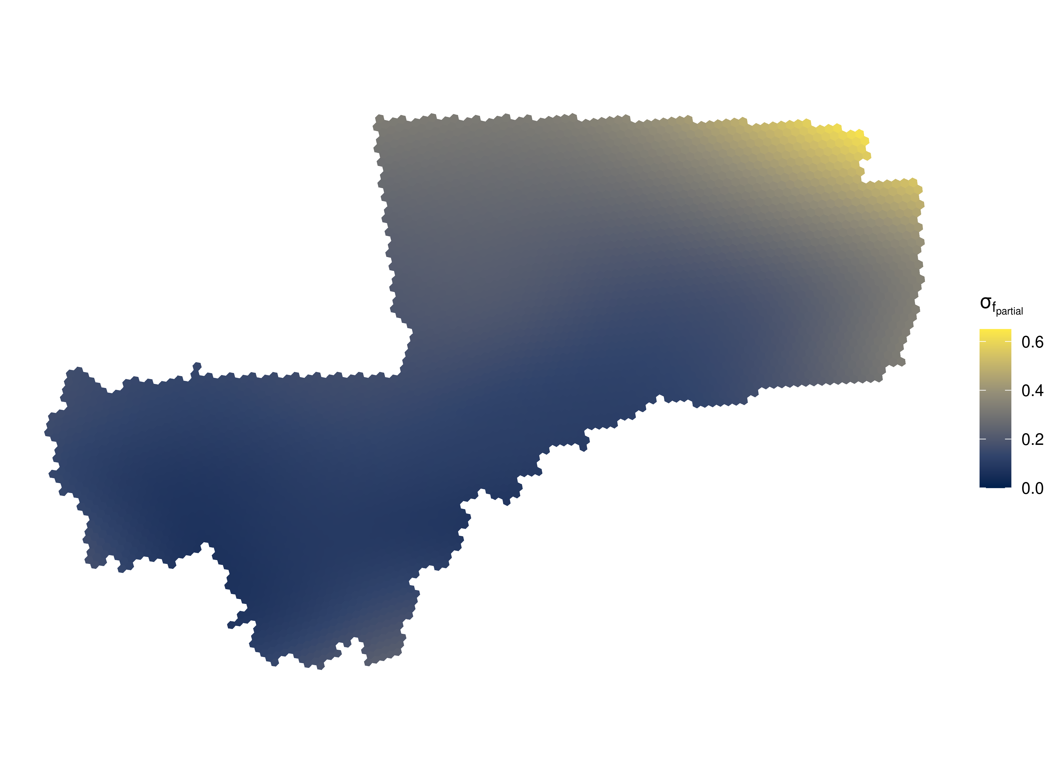
Geographic malaria risk in Mali
Spatial effect (left) and standard error of bootstrap samples (right).

Slide 19
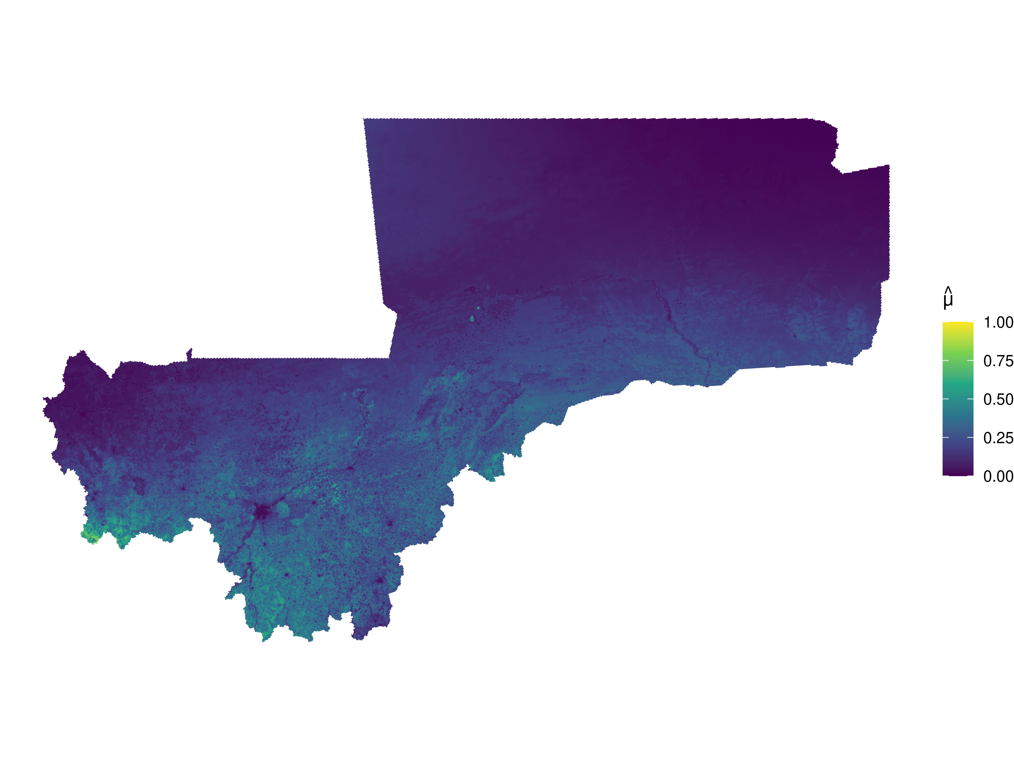
Geographic malaria risk in Mali
Predicted malaria risk.

Slide 20
Discussion

Slide 21
Discussion
Component-wise boosting for risk identification?
Yes, can allow for interesting insights in moderate dimensional datasets where a priori the functional form of an effect is not known, but difficult if rigorous notion of statistical inference is required.
Case Study 1 (Malnutrition)
If effect type selection of interest – great. But difficult to achieve controls for variable selection: stability selection is very conservative in low dimensional settings.
Probably more useful: hierarchical modelling of main factors to distinguish regional differences and deviations from country-level relationship.
Case Study 2 (Malaria)
Likely competitive and interpretable approach compared to Bhatt et al. 2017 and Weiss et al. 2015 with respect to variable selection and predictive accuracy (and: appropriate response distribution).
High accuracy masks large uncertainties in predicted risk, if admin 2 estimates are the objective probably not the right approach (since uncertainty is central).

Slide 22
Q&A

Slide 23
References

Slide 24
References
Bhatt, Samir, Ewan Cameron, Seth R. Flaxman, Daniel J. Weiss, David L. Smith, and Peter W. Gething. 2017. ‘Improved Prediction Accuracy for Disease Risk Mapping Using Gaussian Process Stacked Generalization’. Journal of The Royal Society Interface 14 (134): 20170520. https://doi.org/10.1098/rsif.2017.0520.
Bühlmann, Peter, and Torsten Hothorn. 2007. ‘Boosting Algorithms: Regularization, Prediction and Model Fitting’. Statistical Science 22 (4): 477–505. https://doi.org/10.1214/07-STS242.
Bühlmann, Peter, and Bin Yu. 2003. ‘Boosting With the L ₂ Loss: Regression and Classification’. Journal of the American Statistical Association 98 (462): 324–39. https://doi.org/10.1198/016214503000125.
Dong, Tracy Qi, and Jon Wakefield. 2021. ‘Modeling and Presentation of Vaccination Coverage Estimates Using Data from Household Surveys’. Vaccine 39 (18): 2584–94. https://doi.org/10.1016/j.vaccine.2021.03.007.
Fenske, Nora, Thomas Kneib, and Torsten Hothorn. 2011. ‘Identifying Risk Factors for Severe Childhood Malnutrition by Boosting Additive Quantile Regression’. Journal of the American Statistical Association 106 (494): 494–510. https://doi.org/10.1198/jasa.2011.ap09272.
Friedman, Jerome H. 2001. ‘Greedy Function Approximation: A Gradient Boosting Machine.’ The Annals of Statistics 29 (5): 1189–1232. https://doi.org/10.1214/aos/1013203451.
Giardina, Federica, Nafomon Sogoba, and Penelope Vounatsou. 2016. ‘Bayesian Variable Selection in Semiparametric and Nonstationary Geostatistical Models: An Application to Mapping Malaria Risk in Mali’. In Handbook of Spatial Epidemiology. Chapman and Hall/CRC.
Hans, Nicolai, Nadja Klein, Florian Faschingbauer, Michael Schneider, and Andreas Mayr. 2022. ‘Boosting Distributional Copula Regression’. Biometrics, biom.13765. https://doi.org/10.1111/biom.13765.
Kneib, Thomas, Torsten Hothorn, and Gerhard Tutz. 2009. ‘Variable Selection and Model Choice in Geoadditive Regression Models’. Biometrics 65 (2): 626–34. https://doi.org/10.1111/j.1541-0420.2008.01112.x.
Meinshausen, Nicolai, and Peter Bühlmann. 2010. ‘Stability Selection: Stability Selection’. Journal of the Royal Statistical Society: Series B (Statistical Methodology) 72 (4): 417–73. https://doi.org/10.1111/j.1467-9868.2010.00740.x.
Strömer, Annika, Nadja Klein, Christian Staerk, Hannah Klinkhammer, and Andreas Mayr. 2022. ‘Boosting Multivariate Structured Additive Distributional Regression Models’. https://doi.org/10.48550/arXiv.2207.08470.
Thomas, Janek, Andreas Mayr, Bernd Bischl, Matthias Schmid, Adam Smith, and Benjamin Hofner. 2018. ‘Gradient Boosting for Distributional Regression: Faster Tuning and Improved Variable Selection via Noncyclical Updates’. Statistics and Computing 28 (3): 673–87. https://doi.org/10.1007/s11222-017-9754-6.
Weiss, Daniel J, Bonnie Mappin, Ursula Dalrymple, Samir Bhatt, Ewan Cameron, Simon I Hay, and Peter W Gething. 2015. ‘Re-Examining Environmental Correlates of Plasmodium Falciparum Malaria Endemicity: A Data-Intensive Variable Selection Approach’. Malaria Journal 14 (1): 68. https://doi.org/10.1186/s12936-015-0574-x.

Slide 25
Additional Figures

Slide 26
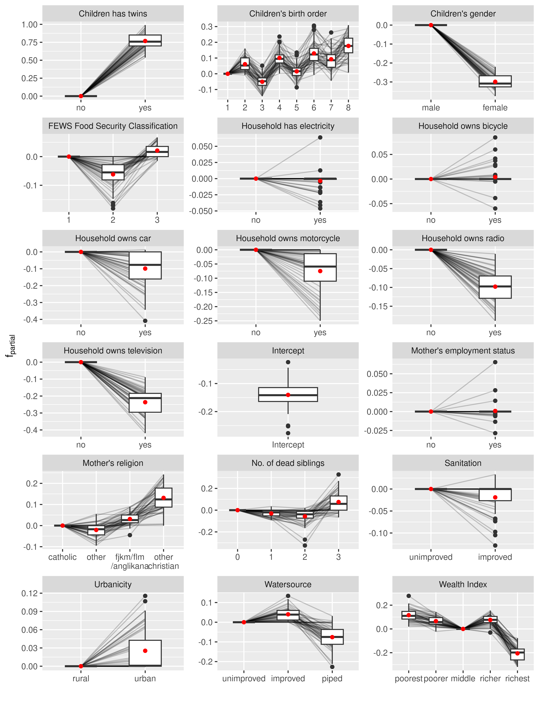
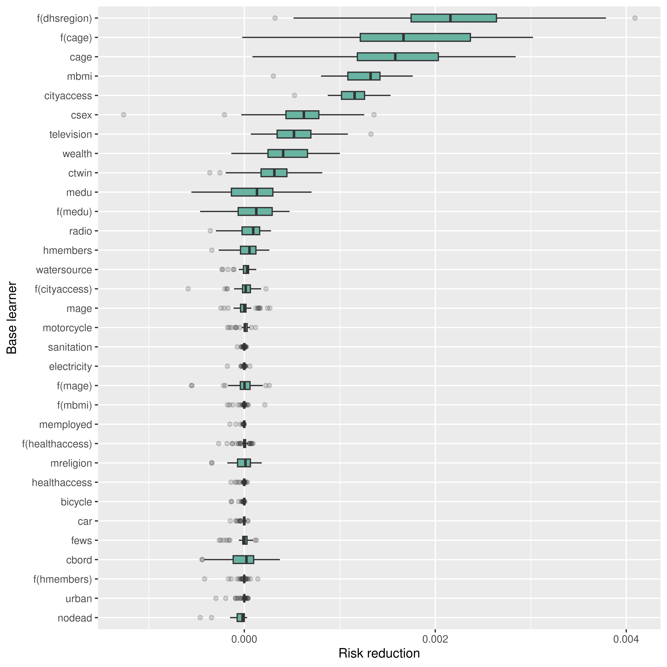

Slide 27
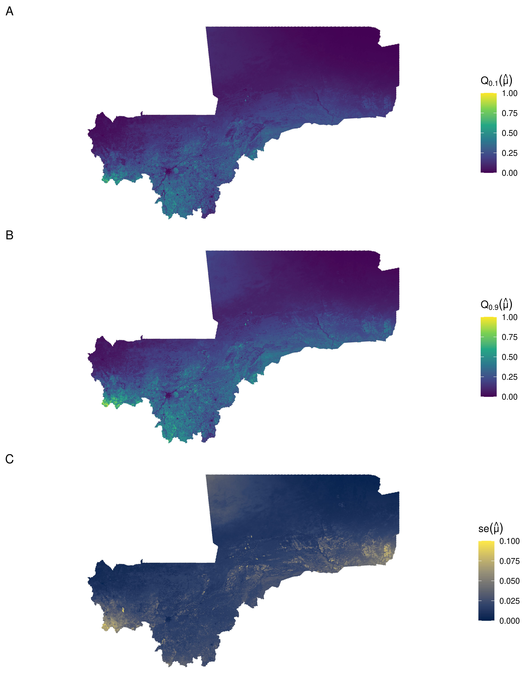
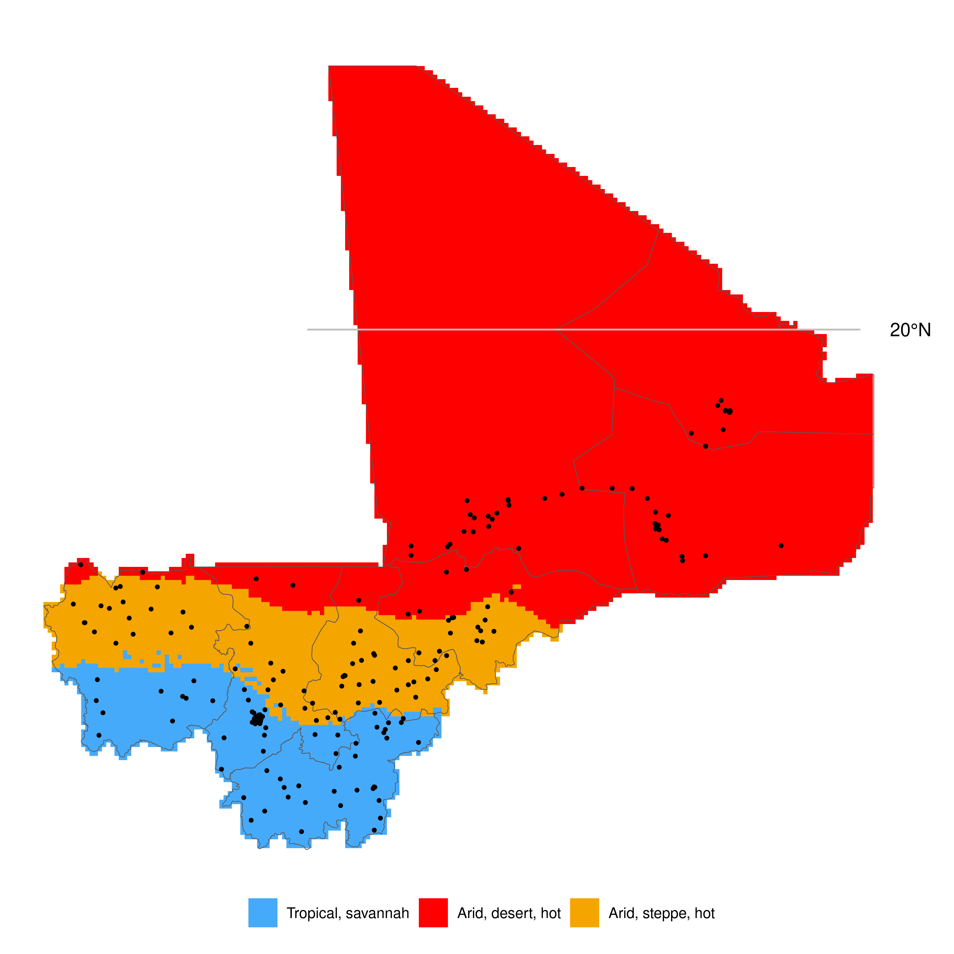

Slide 28
